Slide 1
Promoting Citizen Science through Volunteered Geographic Information -VGI- in Environmental Resource Assessments
Henry N. N. Bulley BMCC, The City University of New York

Slide 2
Overview
Volunteered Geographic Information (VGI)
VGI can be defined as individuals using the Web to create, assemble, and disseminate geographic information (Goodchild, 2007)
Convergence of technological innovation, GPS accuracy, & OpenSource Scripting
OpenStreetmap
Applications in VGI
Kobotoolbox
Case Studies
VGI in Community Flood Mapping in Kampala, Uganda

Slide 3
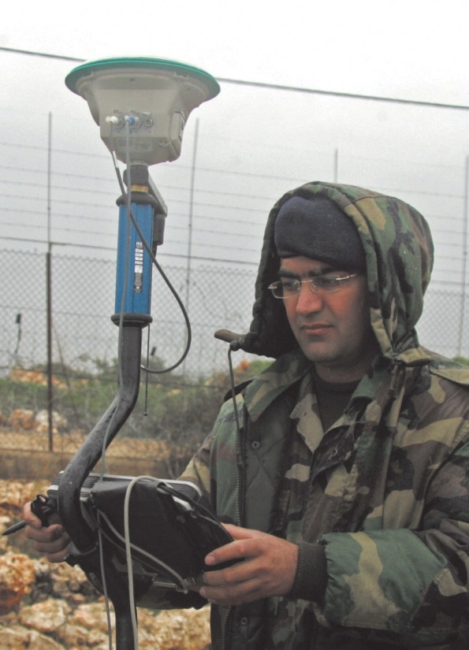
Evolution of Spatial Data Capture
Traditional Government Authority
Experts & Technicians
Citizens’ sensors
Volunteered Geographic Information (VGI) (M. Goodchild 2007)
Citizens generate and share geographic information
Goodchild @ GeoWeb 2008 (8:11 – 9:21)
Geospatial Revolution (Episode One) 0.40 – 1.04
Types of Geographic Information
Locational Information - Place, building, landmark, etc.
Pictures
Videos
Routes, etc
Collecting geographic data in the field, an increasingly common task in many occupations (2000s)
Using a simple GIS in the field to collect data.
The device on the pole is a GPS antenna, used to Georeference data as they are collected (Differential GPS)
(1990s & 2000s)

Slide 4
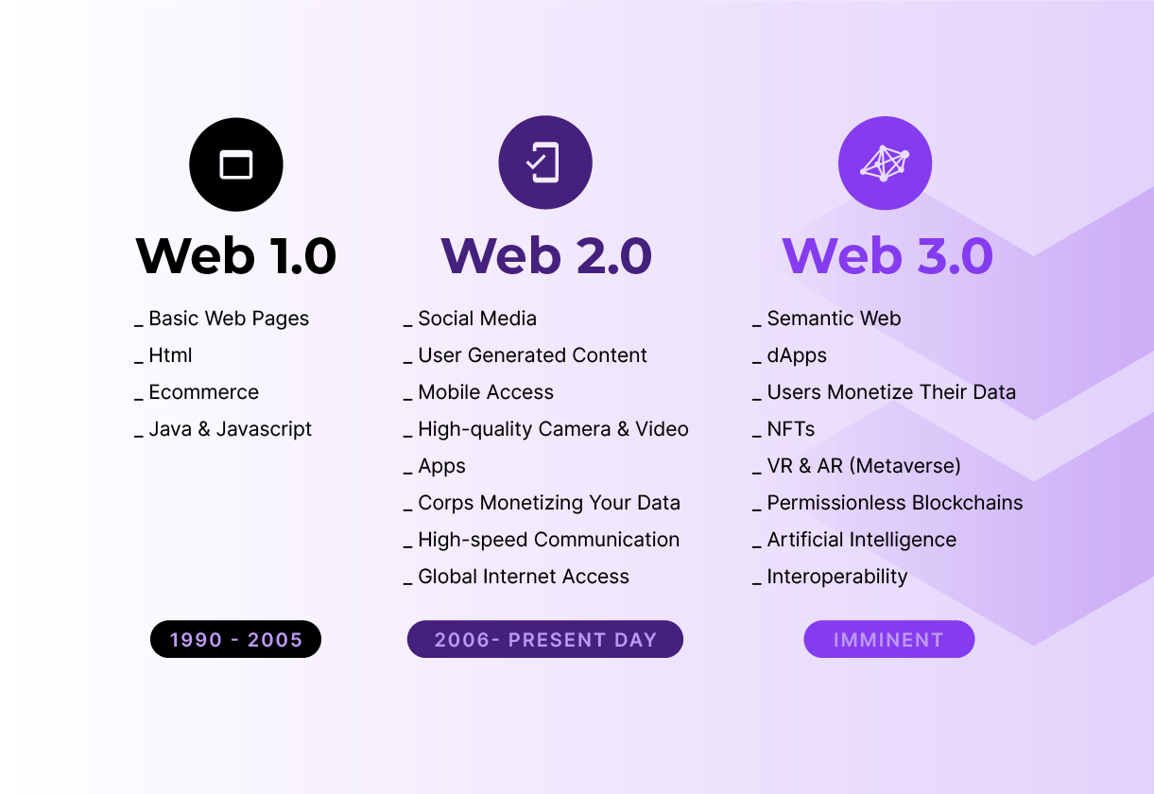
Driving forces behind for Changes in Spatial Data Capture
Emerging Technologies
Web 2.0
Web 3.0 (Spatial/Semantic Web)
Graphics: High-quality 2-D and 3-D graphics
Improved user online interaction
Easily share contents, pictures, videos
Geo-referencing & GPS
Stand-alone, in-dash GPS devices & GSM enabled Smartphones
Removal of the selective availability of the Global Positioning System (GPS) signal in May 2000
Proliferation of GPS receivers and location-based technologies
Geotags: Code that can be inserted into information to note appropriate geographic location.
Geotagged images from smartphones are available in quantities and at temporal and spatial scales that were never seen before and shared in a variety of machine-readable formats
Source: What Is Web 3.0? The Fundamental Guide To The New Era Of Digital Data Ownership

Slide 5
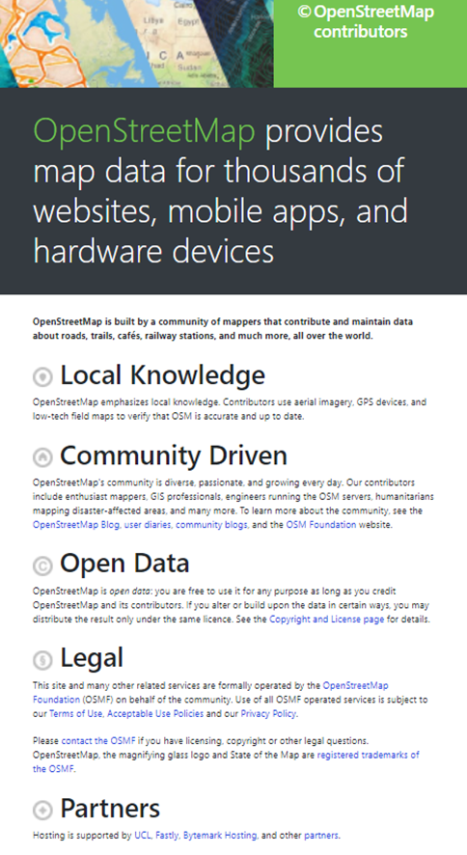
Open Data Standards & OpenStreetMap
Open Data Standards (Open Geospatial Consortium (OGC) standards
OGC (1994) to address spatial data sharing and interoperability within government and industry
Mitigate GIS vendors competitive advantage over spatial data usage
Some Core OGC standards
Simple Features
Geographic Markup Language (GML)
KML(Google) – Initially conceived as competitor to the OGC's GML, but donated to the OGC in 2007
Unified Modeling Language (UML)
Web Mapping Service (WMS)
Web Feature Service (WFS)
Web Coverage Service (WCS)
NYC https://www.openstreetmap.org/#map=12/40.7675/-73.9515

Slide 6
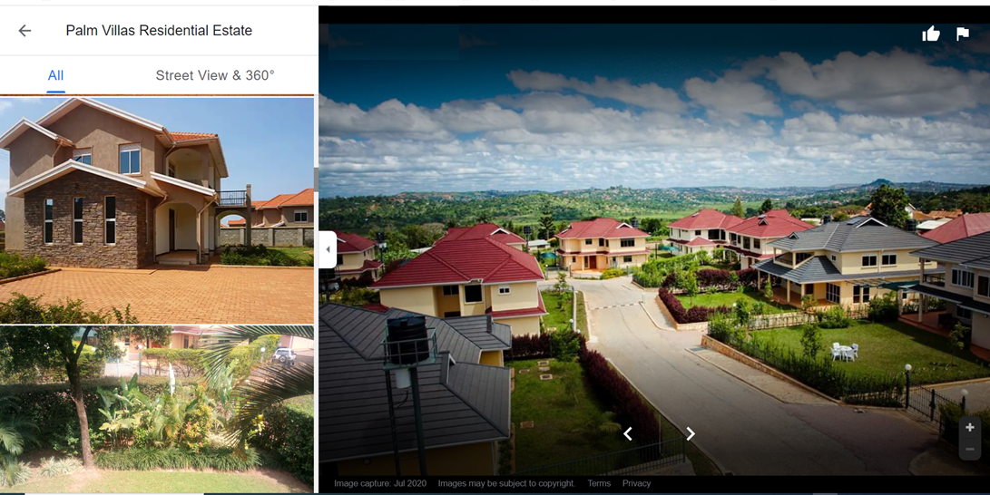
Community Flood Mapping Activity in Bwaise and Kalerwe, Uganda
Part of CADFP fellowship to Uganda in 2019
Major African cities, including Kampala, have experienced rapid population growth and by 2050, the African urban areas are projected to have an additional 950 million people to the current population of about 567 million people
A primary driver of urban settlements is rural-urban migration, mostly youth and educated professionals seeking employment in commercial hubs, in search of better employment opportunities and improved living conditions.
However, an increasing number of rural migrants end up in informal settlements or slums that sprung up in different parts of Kampala district including Bwaise, Kalerwe

Slide 7
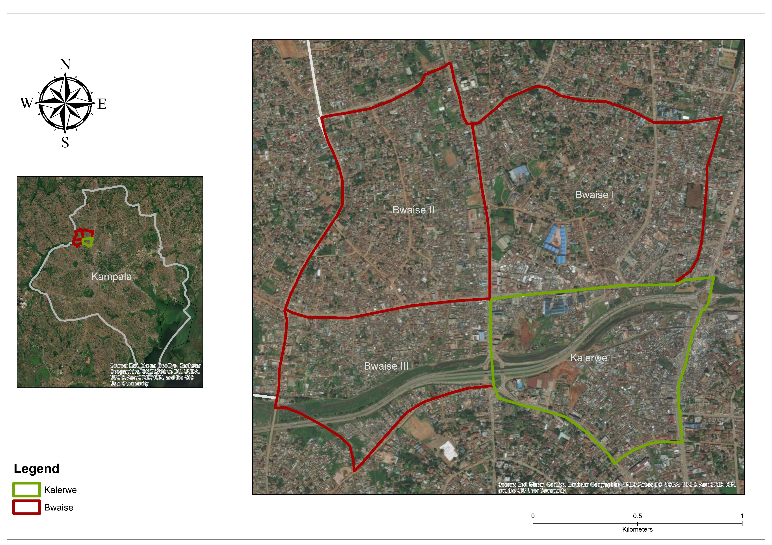
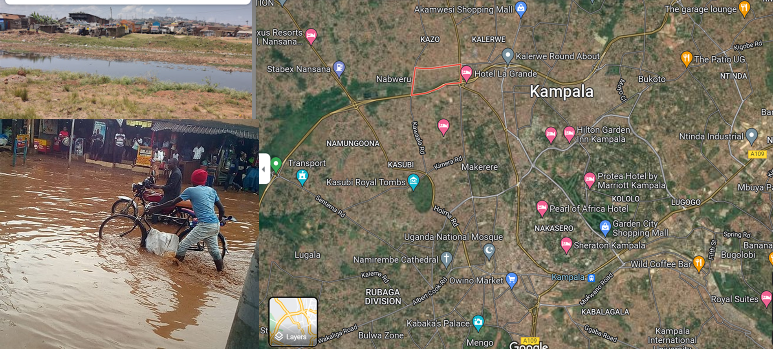
Community Flood Mapping Activity in Bwaise and Kalerwe, Uganda
Bwaise and Kalerwe are parishes are located North of Kampala city’s Central Business District
Both communities are characterized as slum dwellings and represent some of the poorest areas in the city.
They are also located in low lying areas, close to major drainage channels and wetlands which makes them prone to floods and vulnerable to waterborne diseases such as cholera and typhoid

Slide 8
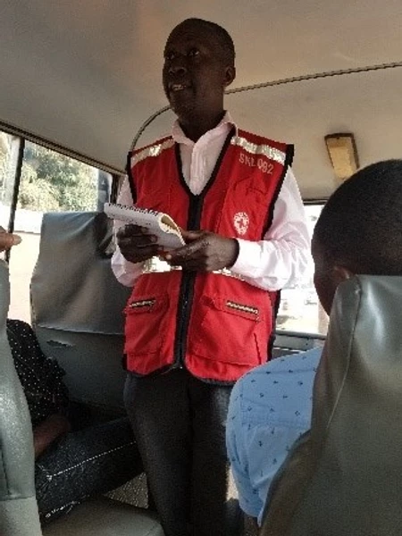
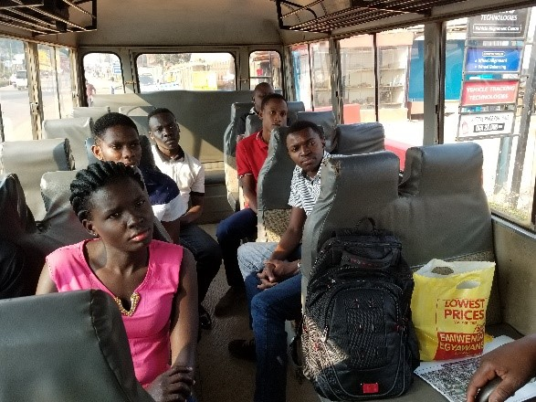
Uganda Red Cross Briefing for YouthMappers Volunteers from Makerere University
Community members are already familiar with the humanitarian activities of the Uganda Red Cross in their communities.
As a result, the authorities and the residents were more receptive and willing to participate in the data collection exercise led by YouthMappers.

Slide 9
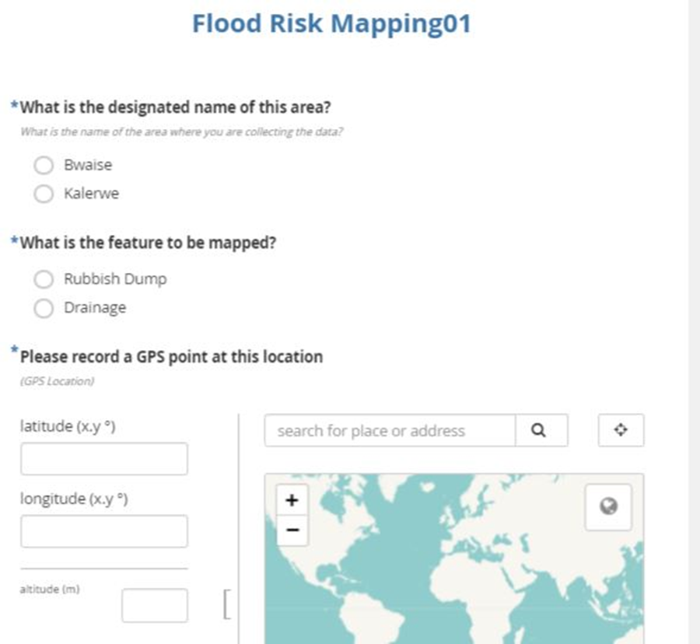
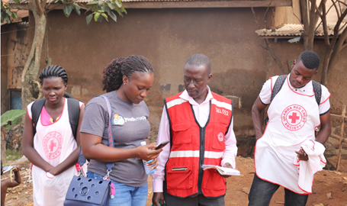
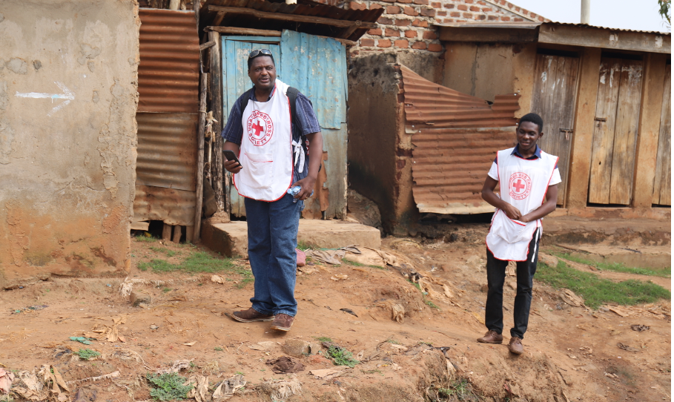
Data Collection Exercise

Slide 10
Results of Community Flood Mapping Activity
 | Bwaise | Kalerwe | Total
Data points collected | 316 | 246 | 562
Rubbish dumps | 149 | 110 | 259
Drainage channels | 167 | 136 | 303
Drainage near road | 26% | 41%
Vegetation close feature | 56% | 46%
Drainage with vegetation | 35% | 31%
Extent of vegetation coverage (%)
Less than 30 percent | 52% | 57%
30 – 50 percent | 33% | 31%
50 – 70 percent | 16% | 5%
More than 70 percent | 0% | 7%
Proportional distribution of data collection points
Of the 167 drainage points collected in Bwaise 26% were near the road network whereas 74% were in drainage channels
56% percent of these had vegetation close to them
35% of the drainage points had grass cover, with 52% of the points having vegetation covering about 30% of the channel

Slide 11
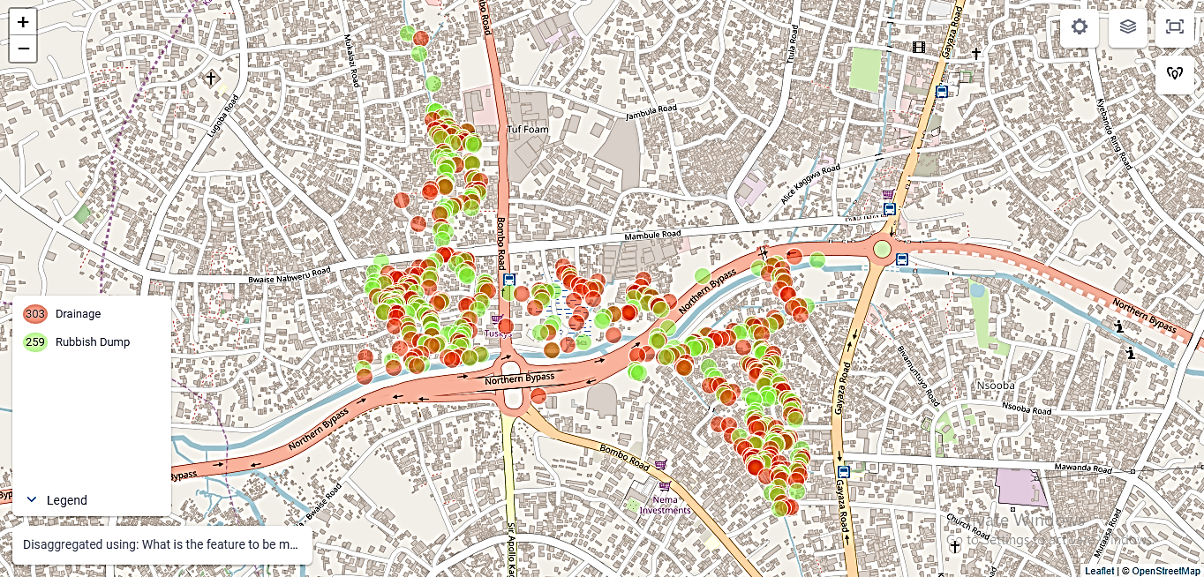
Results of Community Flood Mapping Activity

Slide 12
Conclusions
The community flood vulnerability mapping activity in Bwaise and Kalerwe provides useful in-situ data for Flood Risk assessments for Informal Settlements that are often not easily assessable to urban planners and environmental analysts in Uganda, and across Africa
Will enhance disaster resilience and sustainable mitigation efforts that engage residents in marginal or informal slums settlements
Working with the citizen sensors, GeoYouthMappers chapter in Makerere University, to secure a grant funded and expanded flood disaster resilience data collection
Will be applying same VGI data collection tools in a Belmont Forum funded project in Accra, Ghana in 2023

Slide 13
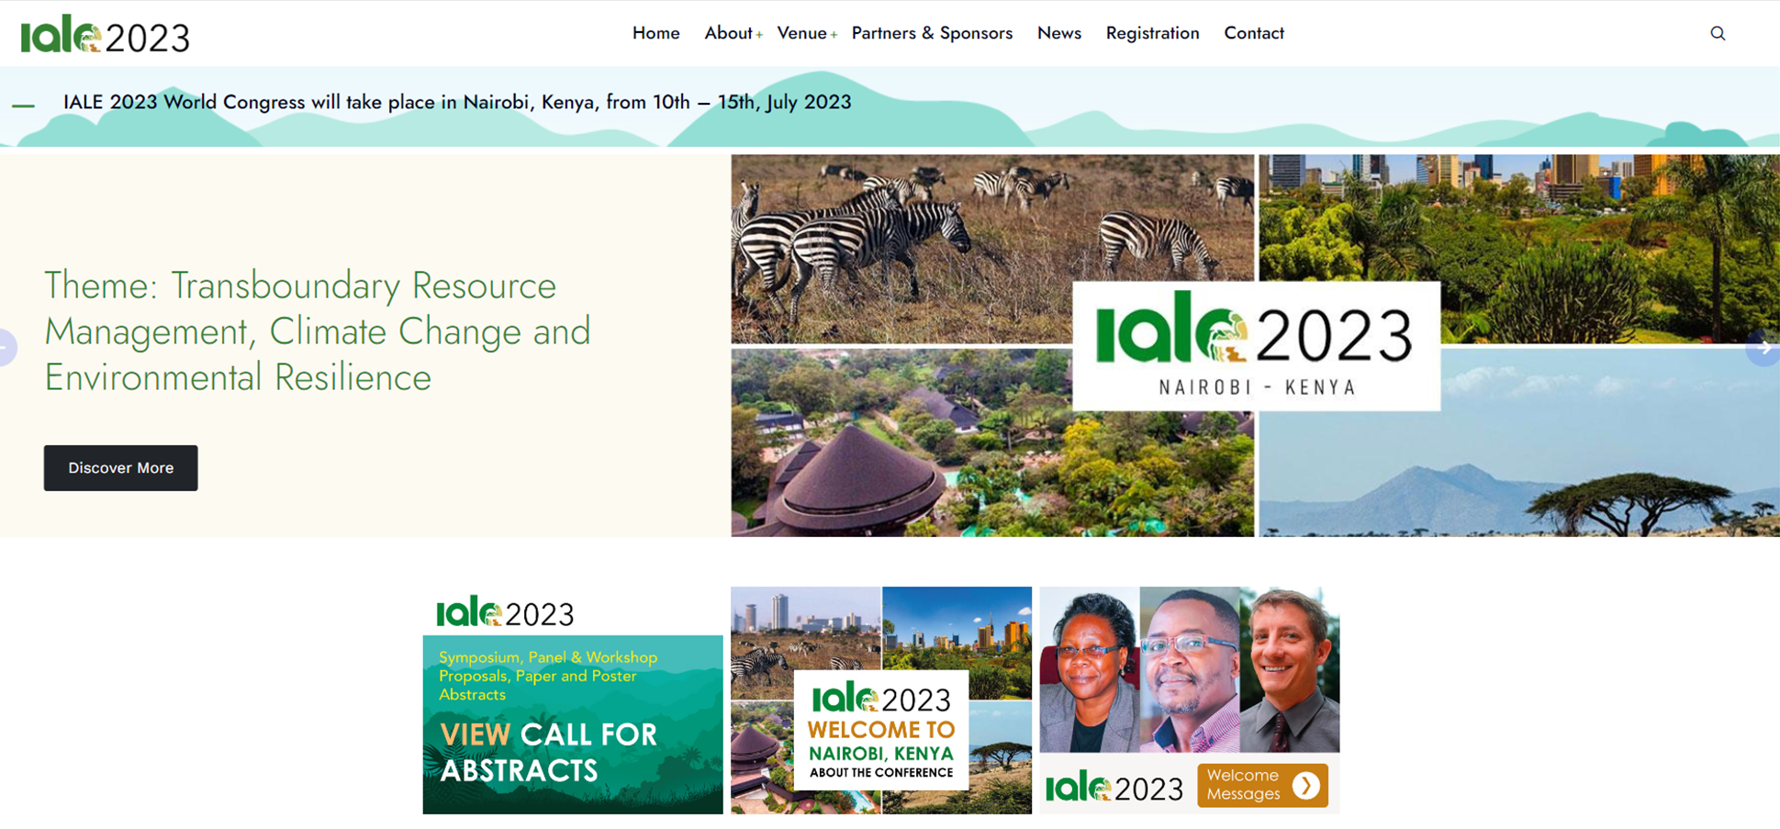
Acknowledgements
IALE 2023 World Congress will take place in Nairobi, Kenya, from 10th – 15th, July 2023

Slide 14
Thank you
Questions?

